Slide 1
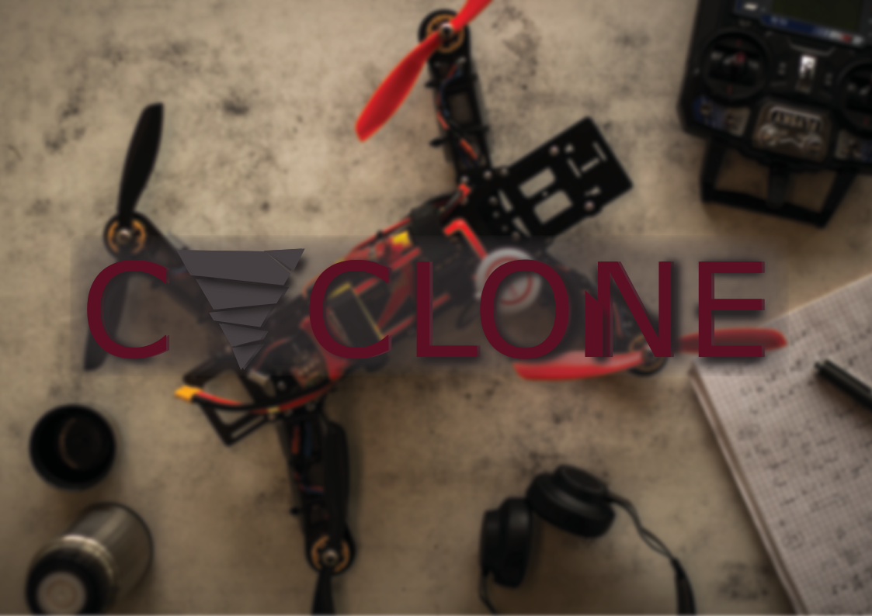
Cyclone Eindhoven
Challenge 1
Andreas Panteli

Slide 2
Contents
Hackathon work
  Process (& Difficulties)
  Result
Cyclone Eindhoven: Autonomous drone racing

Slide 3
Process – first few hours
Edge detection (Canny)
Interesting points detector (Harris)
Feature detection and extraction
Cyclone Eindhoven: Autonomous drone racing

Slide 4
Process – from midnight to 1:00
Shape matching
Circle detection
Grieving
Cyclone Eindhoven: Autonomous drone racing

Slide 5
Process – from 1:00 – 2:00
zzz…
Aruco OpenCV detect corners functions
Cyclone Eindhoven: Autonomous drone racing

Slide 6
Process – Next morning
zzz…
OpenCV camera calibration and estimatePoseSingleMarkers
Distance estimation and staying the heck away from the wall.
Cyclone Eindhoven: Autonomous drone racing

Slide 7
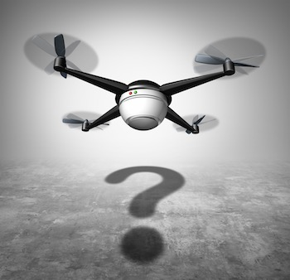
Questions
Cyclone Eindhoven: Autonomous drone racing

